Slide 1




Team Semi-Colon
Hello fellow hackers and judges! We're Team Semi-Colon, a dynamic group of passionate individuals driven by innovation and collaboration from KIET Ghaziabad . With diverse backgrounds, we've come together to tackle challenges head-on and push the boundaries of technology.
We are First Year enthusiast currently experiencing our first Hackathon in your college. At this hackathon, we're excited to tackle the problems stated in your problem statement. Armed with our skills, we’re here to learn and experience more.
Our team thrives on creativity, problem-solving, and a relentless pursuit of excellence. We believe in the power of teamwork and leveraging each other's strengths to create impactful solutions. From brainstorming wild ideas to burning the midnight oil in coding marathons, we're ready to go the extra mile to deliver something extraordinary.

Slide 2
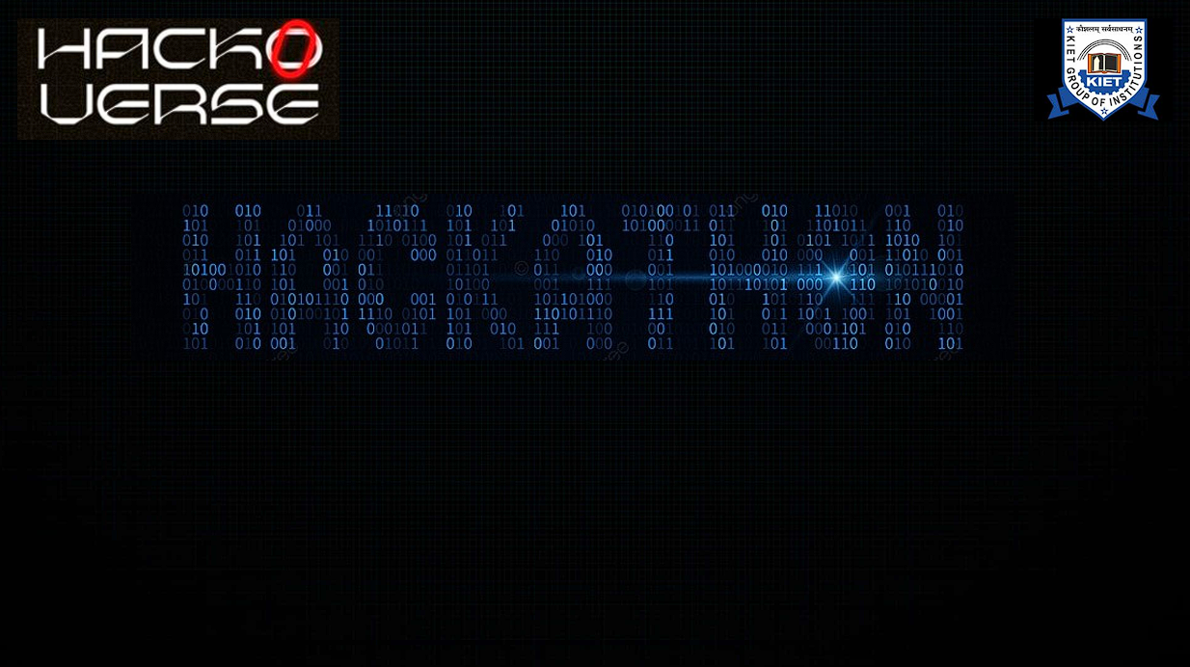
Problem Statement
To create a platform to enhance community-based disaster preparedness and response.
To Develop a userfriendly frontend application for residents to access disaster alerts, evacuation routes, and emergency contacts.
Traditional methods of disseminating information, such as radio broadcasts or paper flyers, often fall short in reaching residents effectively and efficiently.

Slide 3
Proposed Solution
A Community-based Disaster Preparedness Platform is a digital tool designed to empower communities in disaster-prone areas
Echo-Alert is a comprehensive platform aimed at empowering communities to enhance disaster preparedness and response.
Our solution provides a user-friendly frontend application that enables residents to access critical information such as disaster alerts, evacuation routes, and emergency contacts seamlessly.
Provides alternated routes that are clear for evacuation also indicates the places that are not affected yet.

Slide 4
Benefits and impact solution will create
Creating a platform to enhance community-based disaster preparedness and response, along with a user-friendly frontend application for residents, offers numerous benefits and can have a significant impact. Here are some of the key benefits and impacts:
Timely Access to Critical Information
Improved Community Resilience
Increased Public Safety and Well-being
Inclusivity and Accessibility
Community Engagement and Collaboration

Slide 5
Market and opportunity
The market and opportunities for a platform aimed at enhancing community-based disaster preparedness and response are significant and varied. Here's an overview of the market landscape and the opportunities it presents:
Growing Concerns About Disaster Preparedness
Government Initiatives and Funding
Corporate and Social Responsibility
Technological Advancements
Community Engagement and Empowerment
Global Reach and Scalability

Slide 6
TECH STACK USED
JAVA
XML
GEOLOCATION
ANDROID STUDIOS

Slide 7
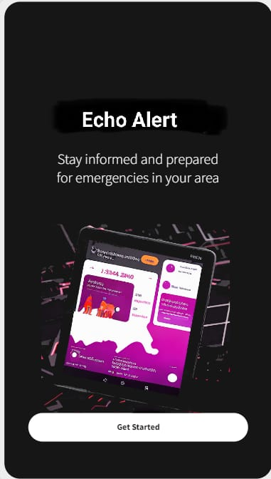
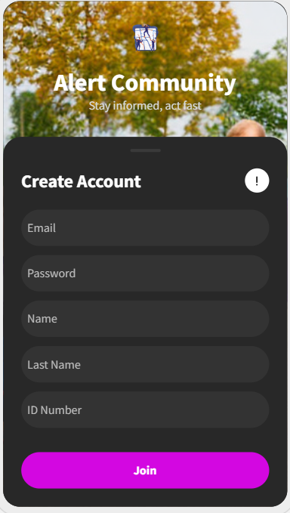
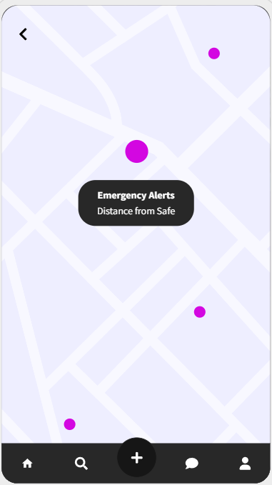
User-Interface

Slide 8
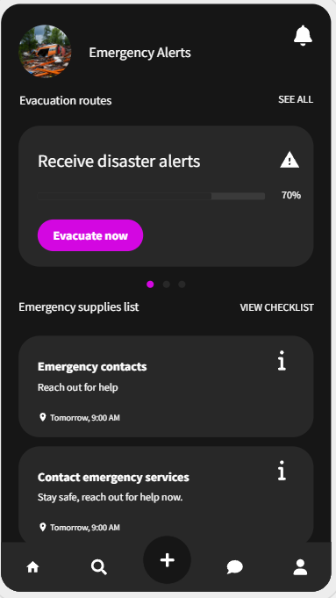
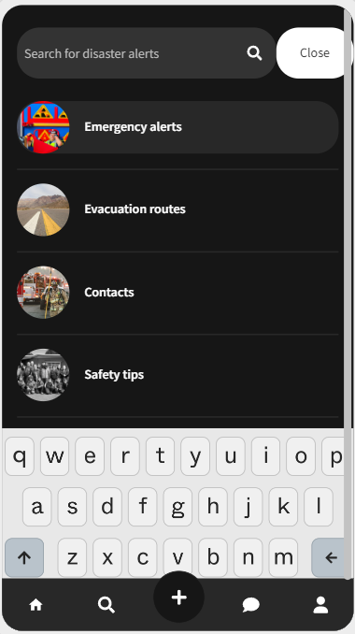
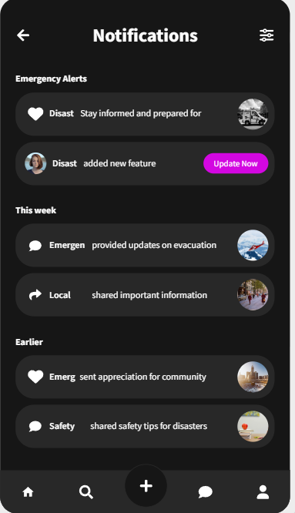
User-Interface

Slide 9
TEAM SEMI-COLON
Thank You !
Group Leader : Shreyansh Singh (23-27)
Members : Siddharth Gautam (23-27)
Prashant Singh (23-27)
Samarth Singh (23-27)

